Slide 1


Robot Operating System
Presenter: Jian.Yin
2019/10/18

Slide 2

Contents.
01
Introduction of ros
02
Ros engineering structure
03
Ros communication architecture
04
Ros tools
知行合一、经世致用
Central South University
Notes:
sfddfsdf

Slide 3


01
Introduction of ros
自强不息 厚德载物
知行合一、经世致用
Tsinghua University of China
Central South University
Notes:
Robot Operating System 机器人操作系统，简称ROS。
人工智能的浪潮中有一个方面是不可忽视的，就是机器人。 说到我们今天的机器人，最近几年机器人领域非常火爆，出现了一大批这样高质量的产品。
例如，波士顿动力的机器狗，谷歌的无人车，以及国产的大疆无人机等等。
而这当中许多用到了一个共同的运行支撑软件。就是机器人操作系统ROS。

Slide 4

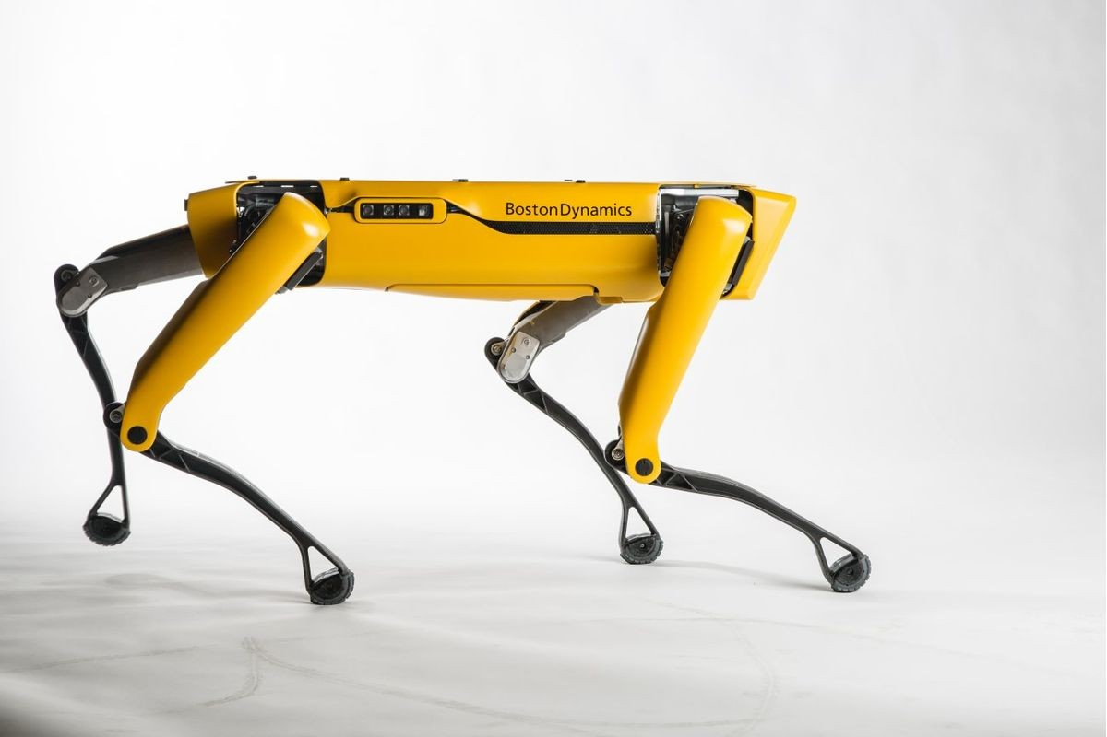
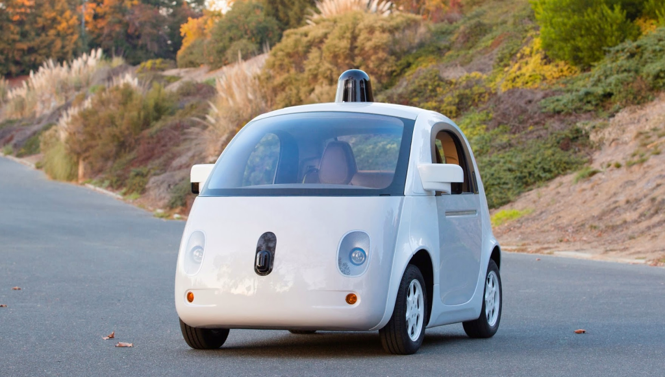

Introduction of ros
01
Robot operating system
知行合一、经世致用
自强不息 厚德载物
Central South University
Notes:
when it comes to ...
many of these use

Slide 5


Introduction of ros
01
Ros is middleware
知行合一、经世致用
自强不息 厚德载物
Central South University
Notes:
it connect the

Slide 6









Introduction of ros
01
Origin
2000，Stanford University
Release
2007，Willow Garage
ROS 1.0
2010
ROS Indigo(LTS)
2014，14.04
ROS Hydro
2013
ROS Jade
2015
ROS Kinetic(LTS)
2016，16.04
ROS Lunar
2017
知行合一、经世致用
自强不息 厚德载物
自强不息 厚德载物
Tsinghua University of China
Central South University
Notes:
has a history of 20 years. first in 2000

Slide 7

Introduction of ros
01
Definition
知行合一、经世致用
自强不息 厚德载物
Central South University
Notes:
Ros official give the Definition.

Slide 8
02
Ros engineering structure
自强不息 厚德载物
知行合一、经世致用
Tsinghua University of China
Central South University
Notes:
in the scecond part,

Slide 9
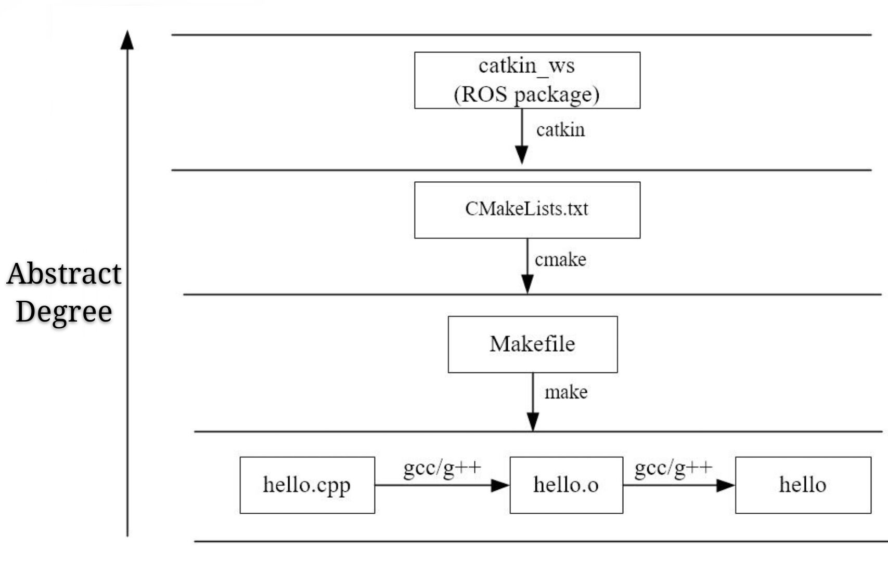
Ros engineering structure
02
知行合一、经世致用
自强不息 厚德载物
Tsinghua University of China
Central South University
Notes:
a ros project use cmake compiler

Slide 10
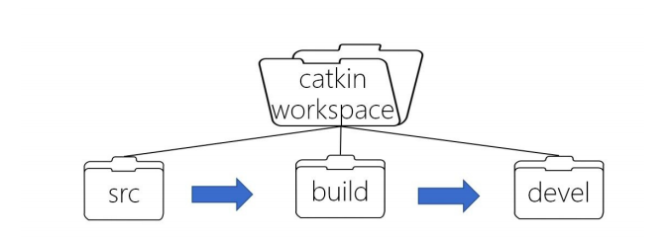

Ros engineering structure
02
知行合一、经世致用
自强不息 厚德载物
Tsinghua University of China
Central South University
Notes:
This picture shows the ...,
we can see that catkin ...

Slide 11
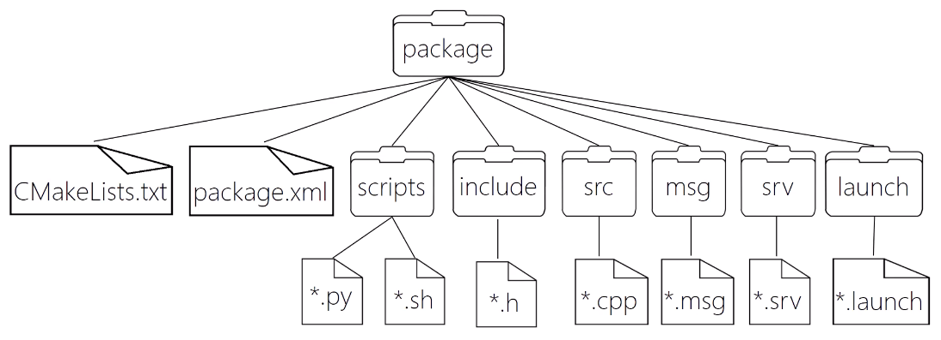
Ros engineering structure
02
知行合一、经世致用
自强不息 厚德载物
Tsinghua University of China
Central South University
Notes:
this picture shows the compostion of a package.

Slide 12
03
Ros communication architecture
自强不息 厚德载物
知行合一、经世致用
Tsinghua University of China
Central South University
Notes:
in the third part, we will talk about

Slide 13
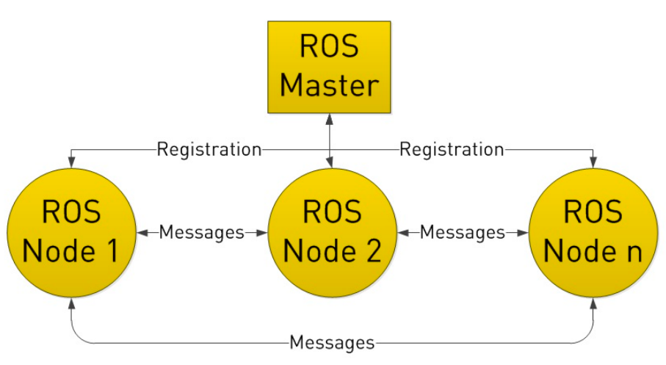
Ros communication architecture
03
知行合一、经世致用
自强不息 厚德载物
Tsinghua University of China
Central South University
Notes:
A robot has many nodes. for excample , some node..
ros has ros master to manager ...

Slide 14




Ros communication architecture
03
Topic
Parameter Service
Service
Actionlib
知行合一、经世致用
自强不息 厚德载物
Tsinghua University of China
Central South University
Notes:
the communication method is core. There are..

Slide 15
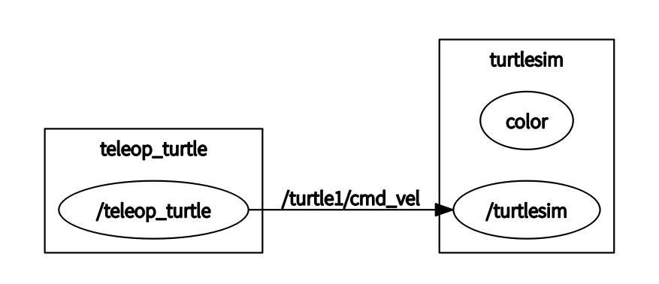
Ros communication architecture
03
Topic
知行合一、经世致用
自强不息 厚德载物
Tsinghua University of China
Central South University
Notes:
topic is most common ways to commuication, it is the best choice for real-time message.
the process of topic communication is that, publisher node and subscriber node registered at ros master.

Slide 16

Ros communication architecture
03
Service
知行合一、经世致用
自强不息 厚德载物
Tsinghua University of China
Central South University
Notes:
service is a request and reply comminucation. when some node need data temporarily, service is ...
it is achieved by tcp-ip

Slide 17

Ros communication architecture
03
Parameter server
知行合一、经世致用
自强不息 厚德载物
Tsinghua University of China
Central South University
Notes:
parameter server is a special method, it is different from ...

Slide 18
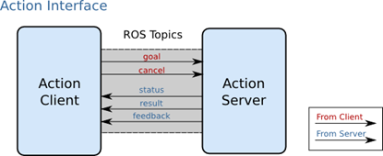
Ros communication architecture
03
Actionlib
知行合一、经世致用
自强不息 厚德载物
Tsinghua University of China
Central South University
Notes:
actionlib is simliar to service. but ...

Slide 19
04
Ros tools
自强不息 厚德载物
知行合一、经世致用
Tsinghua University of China
Central South University
Notes:
in the fourth part, we will talk about ros tools

Slide 20
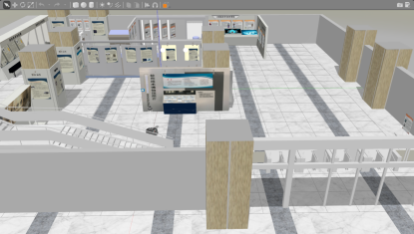
Ros tools
04
Gazebo
Simulation tool
知行合一、经世致用
自强不息 厚德载物
Tsinghua University of China
Central South University
Notes:
gazebo is simulation tool, in the early stage, we did the test work on gazebo.
we can find bugs in the code to prevent our robot from exploding.

Slide 21
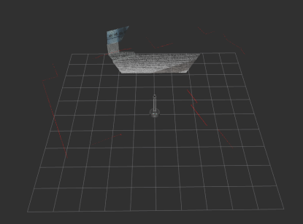
Ros tools
04
RViz
Visualization tool
知行合一、经世致用
自强不息 厚德载物
Tsinghua University of China
Central South University
Notes:
Rviz is a vi... tool. it allow us to see images and other data in real time. so that we can...

Slide 22
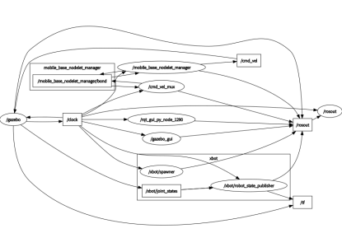
Ros tools
04
Rqt
Visualization tool
知行合一、经世致用
自强不息 厚德载物
Tsinghua University of China
Central South University
Notes:
Rqt is also a vi... tools, but it can display the architecture of the system.

Slide 23
Thanks for all

